Slide 1
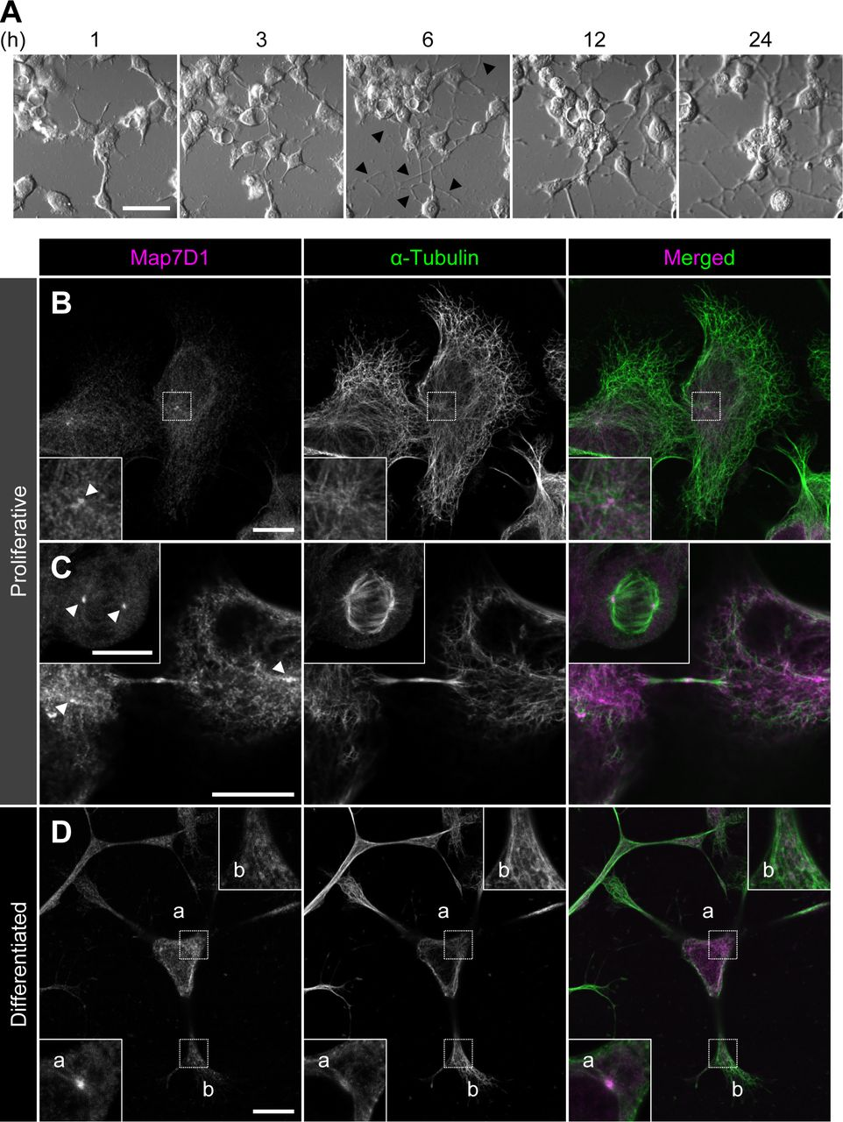

Subcellular localization of Map7D1 in proliferative and differentiated N1-E115 cells.
Koji Kikuchi et al. LSA 2022;5:e202201390
© 2022 Kikuchi et al.
Notes:
Subcellular localization of Map7D1 in proliferative and differentiated N1-E115 cells. (A) Neuronal differentiation of N1-E115 cells was induced by decreasing the concentration of fetal bovine serum in the medium to 0.5% fetal bovine serum and adding 1% dimethylsulfoxide. Arrowheads indicate elongated neurites. After 6 h of induction, elongated neurites were observed. (B, C, D) Localization of Map7D1 in interphase (B), mitosis (C), and differentiation state (D) of N1-E115 cells. Cells were double-stained with anti-Map7D1 and anti–α-tubulin antibodies. In (B), the insets show enlarged images of regions indicated by a white box. In (C), the inset shows metaphase cells. In (D), images of differentiated cells were captured by z-sectioning because the focal planes of the centrosome and neurites are different. Each inset shows an enlarged image of the region indicated with a white box at each focal plane. Arrowheads show centrosomal localization of Map7D1. Data information: scale bars, 50 μm in (A) and 10 μm in (B, C, D).

